Slide 1
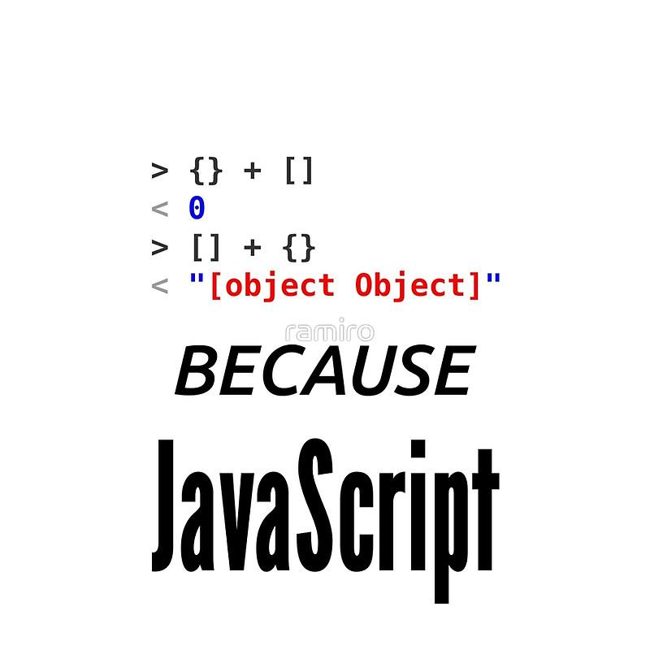

Web Dev 4
More JS
tinkercademy.com

Slide 2
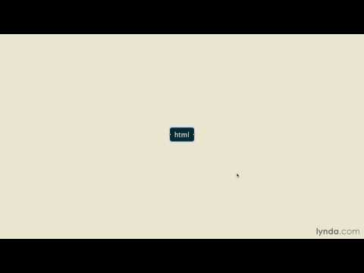
The DOM
The DOM

Slide 3
Manipulating the DOM
Go to jquery.com, and type these into the console:
> document.getElementsByTagName("h2")
> document.getElementsByTagName("h2")[0]
> document.getElementsByTagName("h2")[0].innerHTML
> document.getElementsByTagName("h2")[0].innerHTML = "I enjoy eating potatoes"
We’re using JavaScript to manipulate the DOM, i.e. the downloaded webpage. There are many document-related functions—try typing document.get, then pressing tab.

Slide 4
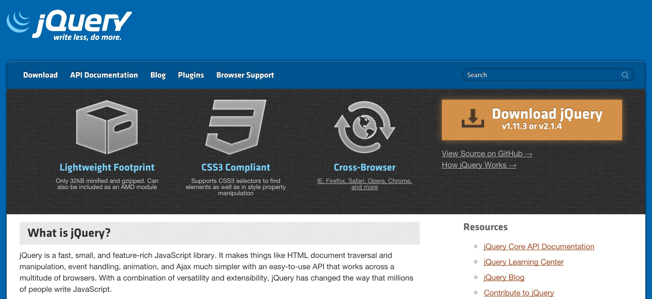
jQuery
The only JavaScript library you’ll ever need
Simplifies a lot of functions
Cross-browser compatibility
Adds a ton of extra functionality

Slide 5
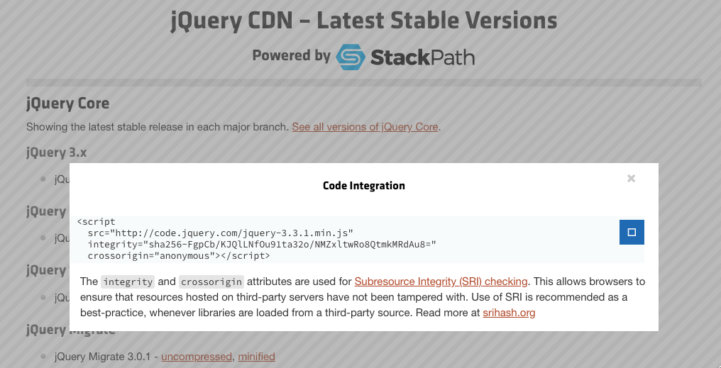
Add jQuery
Go to the jQuery CDN: http://code.jquery.com/
Click on the first “minified”
Copy the link
Paste this into your HTML file, in <head>

Slide 6
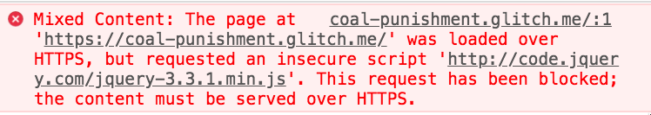
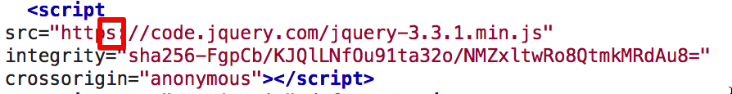
Error?
If your website is loaded with HTTPS, your jQuery should also be loaded with HTTPS
Change to:

Slide 7
Easier Selecting with jQuery
$('your selector here') will select the element <your selector here> You can use any valid CSS selector here.
$('#itemID') selects the element with ID itemID
$('.classID') selects the elements with class classID
To get the first, use $('.classID')[0]
Go to a site with jQuery enabled, e.g. www.jquery.com (obviously). Try some selectors!
> $('#container')
> $('.menu-item')
> $('.menu-item')[0]

Slide 8
Anatomy of a jQuery statement
$("#submitButton").hide()
$( ) → jQuery Function
"#submitButton" → selector (like in CSS)
.hide() → jQuery function to hide an element

Slide 9
What to do with selections?
Hide and show:
> $('#container').hide();
> $('#container').show();
Change its CSS:
> $('#container').css('background-color', 'red');
Animate changes:
> $('#container').fadeOut(200);
> $('#container').fadeIn(500);
> $('#container').slideUp(200);
> $('#container').slideToggle();

Slide 10
Making things happen
You don’t expect your users to open up their consoles to type stuff in!
You can add an onclick attribute to a link with a blank href (#):
<a href="#" onclick="runThis()">Run this!</a>
Then in your JS, add a function with what you want to happen:
var runThis = function() {
$('#container').hide();
}

Slide 11
Making things happen at start
Sometimes, you want things to happen after the page finishes loading.
To do this, add this to your JS:
$(function() {
// put your code here, e.g.
alert("Hello! Your page is done!");
});

Slide 12
JavaScript vs. jQuery
document.getElementById("id").style.top="50px";
document.getElementById("id").style.left="25px";
document.getElementsByClassName("inactive").style.display="none";
$("#id").css("top","50px").css("left","25px");
$(".inactive").hide();
Notes:
Apologies to anyone colour-blind…

Slide 13
JavaScript vs. jQuery
document.write("lorem");
document.write("ipsum");
document.getElementById("textField").value=20;
$(document).append("lorem").append("ipsum");
$("#textField").val(20)

Slide 14
Summary
Add onclick="functionName()" as an attribute to your <button> or <a> tag
Add a new function to your JavaScript, using that same functionName
var functionName = function() {
// do stuff here
}
Use your selectors and functions to do things!
Here’s an example of toggling with some logic and a variable.

Slide 15
Exercise
Spruce up your profile page with some interactivity!
Make things animate when clicked on, by combining jQuery with Animate.css. Simply use jQuery’s addClass to include animated to get something to move!

Slide 16
Exercise
Refactor your table generator (from previous JS lesson) code to use jQuery instead
Code refactoring is the process of restructuring existing computer code–changing the factoring–without changing its external behavior.
If you haven’t yet, set up two <input> fields in your HTML, to let the user enter the row and column info
How to get the values from these fields with jQuery?
Set up a <button> field to handle the onClick
Bonus: Use a jQuery event to handle the onClick, instead of embedding an onClick handler in your HTML!
Read ahead to next set of slides for more info
Read: https://api.jquery.com/click/

Slide 17
Event Handling

Slide 18
Events
Events are….events that happen when a user does something
Lets you bind particular bits of code to run only when something happens
Put this in the JS file
Why not just have things in HTML onClick?
Not separating form and function
We try to keep the HTML for just presentation and setup, and any functionality in the JS file
Can add multiple behaviours without duplicating code

Slide 19
Events in jQuery
$("#submit").on("click",function(e){
alert("Clicked submit!");
});
Watch out for the odd-looking syntax—that’s a function definition acting as an argument
Don’t forget the closing semicolon! Because your line is actually just $("#submit").on("click",something);

Slide 20
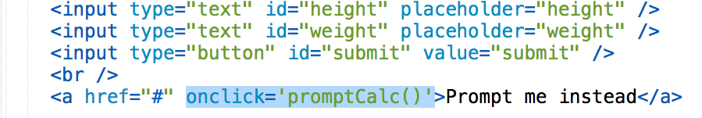
Before Events:
This may be how you had it in HTML:

Slide 21
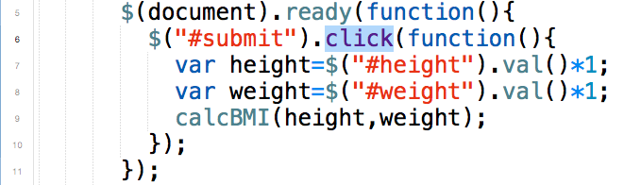
With Events
Now all in JS, no need onClick in HTML

Slide 22
Exercise:
Make a calculator in HTML/Javascript
It should minimally support +-x÷, and work like those basic solar-powered calculators
If you’re done, extend it! Add exponents, brackets, and trig functions.

Slide 23
Using Your Powers for Evil

Slide 24
Exercise
Make a Rickroll spammer. One click on a button will bring up:
A video of “Never Gonna Give You Up” in the middle of the page
Hint: You can have it already on your page, but hidden, and show it only when the button is pressed
Get it to autoplay
Hint: use jQuery’s attr() to change the iframe’s src attribute
Generate a new video every couple of seconds, and append it
Hint: jQuery setInterval(), clone(), insertAfter()
Place it somewhere random on the page
Hint: use position: absolute for your CSS, and adjust the top and left with random numbers (Google)
CHAOS

Slide 25
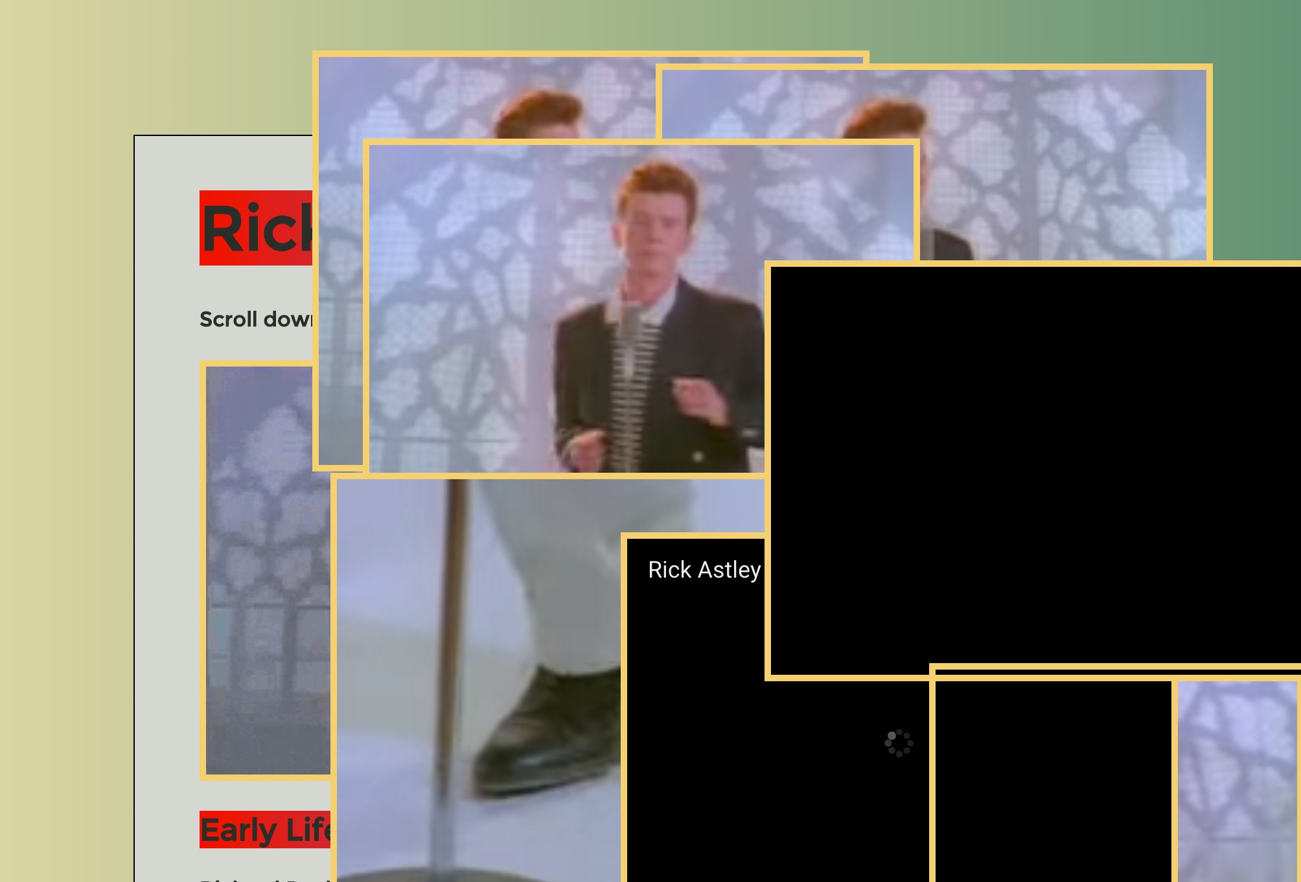
Agggh (GIF demo)

